Slide 1
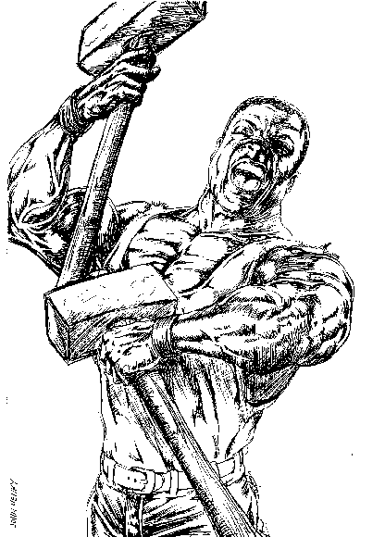
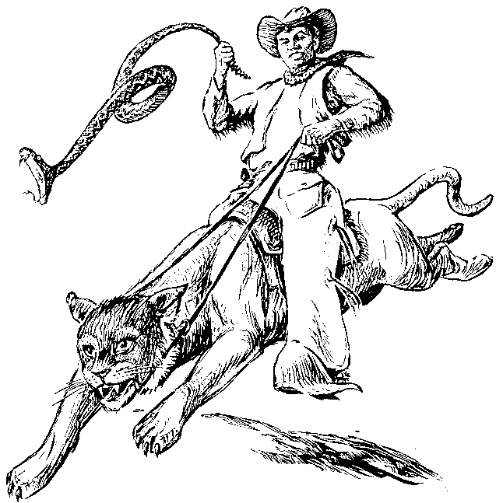
American Stories and Folklore
Students of all skill levels are welcome to learn about America’s grand tradition of tall tales and famous folklore.
Come to Room 308 at 16:30 on March 21st to hear stories of adventure, history, romance, and horror!
Hosted by Adam Emerson, Fulbright English Teaching Assistant from the United States.

