Slide 1
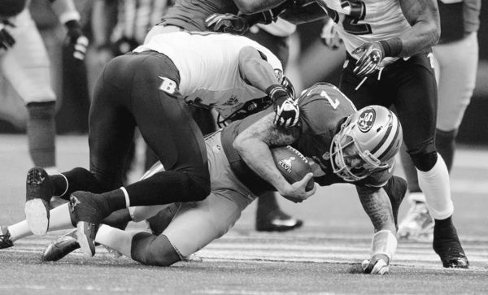
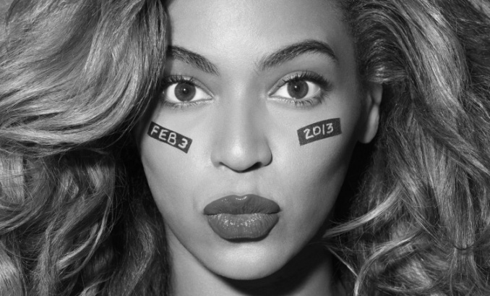
Super Bowl Party
Students of all skill levels are welcome to learn about American football, tailgating, Beyonce, and all the other things that make the Super Bowl great!
Come to Room 308 at 16:30 on February 21st to see why Americans love this sport so much!
Hosted by Adam Emerson, Fulbright English Teaching Assistant from the United States.

