Slide 1
Cultural treasures and traditions in Iraq

Slide 2
My presentation is about:
Iraq and its facts
Nationalities and religions in Iraq
Why Arabic language is popular and
beautiful and also why it is difficult to learn
Iraqi Culture
And so on….

Slide 4
The borders of Iraq and its neighbors

Slide 5
It is the capital of Iraq. The city was built by the Caliph Al Mansur in the 8th century. It has several names for examples: the round city, the city of peace
Baghdad

Slide 6
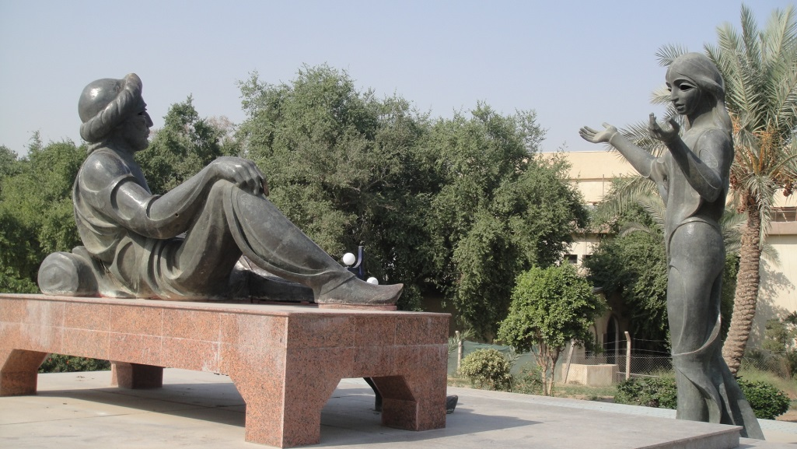
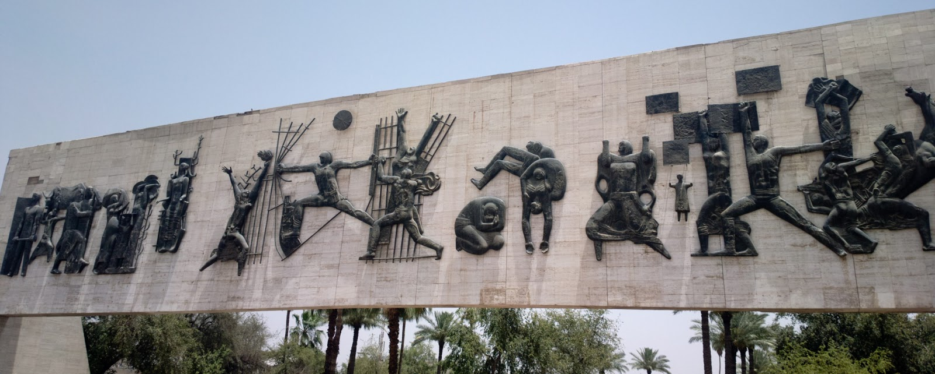
Al-Safafeer market in Baghdad
1001 nights
The freedom square

Slide 7
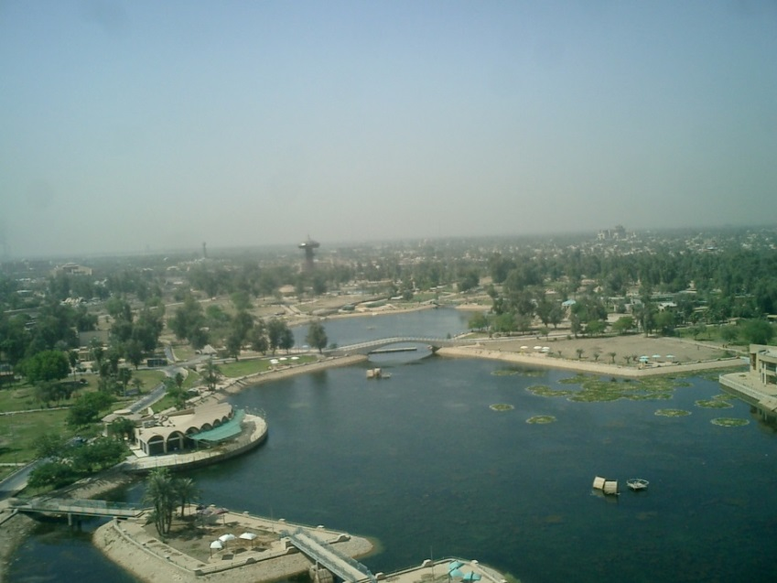
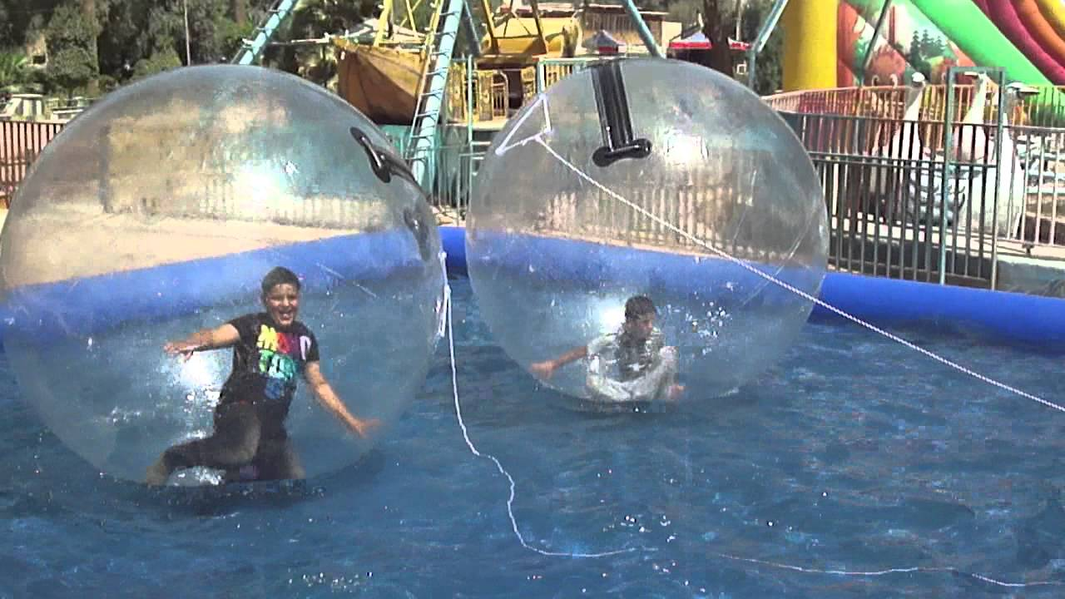
AlZawraa Park

Slide 8
Facts about Iraq:
The earlier name of Iraq was Mesopotamia, is often referred to as the cradle of civilization. Iraq occupies the ancient region of Mesopotamia, "land amidst the rivers," fertile lowland created by the Tigris and Euphrates Rivers.
Ancient Iraq was the birthplace of some of the world’s most important inventions, such as the 60-second minute and the 60-minute hour, the wheel, writing, the first accurate calendar, the first maps, and the first schools.

Slide 9
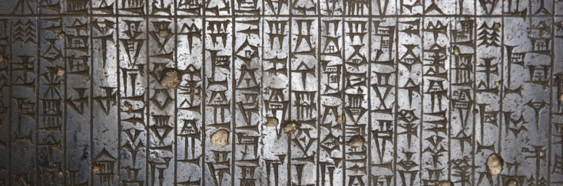
The oldest known writing system developed in Iraq around 3200 B.C. Known as cuneiform, it used about 600 signs instead of an alphabet. Each sign stood for a word or a syllable.
The Epic of Gilgamesh, the world’s first written story, narrates the adventures of a legendary king who fought to preserve an ancient Iraqi city
The famous children’s story Ali Baba and the Forty Thieves was written in Iraq about 1,000 years ago.

Slide 10
Treasures of Iraq

Slide 11
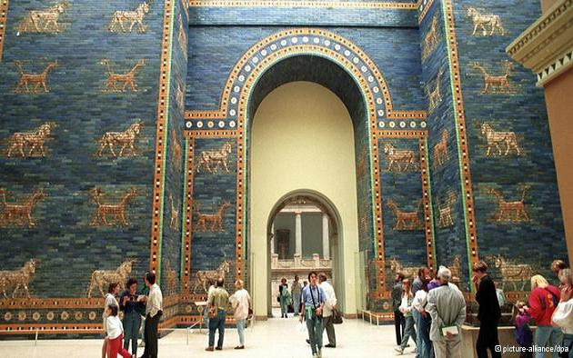
Ishtar Gate in Berlin Museum

Slide 12
Hammurabi’s Code in Louvre Museum

Slide 13
Winged Bull in Louvre Museum

Slide 14
Nationalities, religions:
Iraqi Arabs including 72-75%.
Kurds including 20-22%.
Turkmen: 2%, Assyrians: 2%, others: 1%.
96% of Iraqis follow Islam.
Christianity accounts for 0.8%, and the rest practice Mazdeism, Yezidism and other religions.
A few Jews remain in Iraq.

Slide 15
Iraqi Culture and cuisine

Slide 16
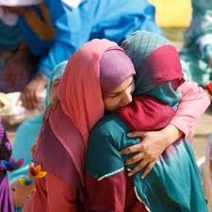
Meeting people
السلام عليكم
(Assalaam alaikum)

Slide 17
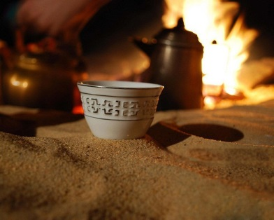
Hospitality

Slide 18
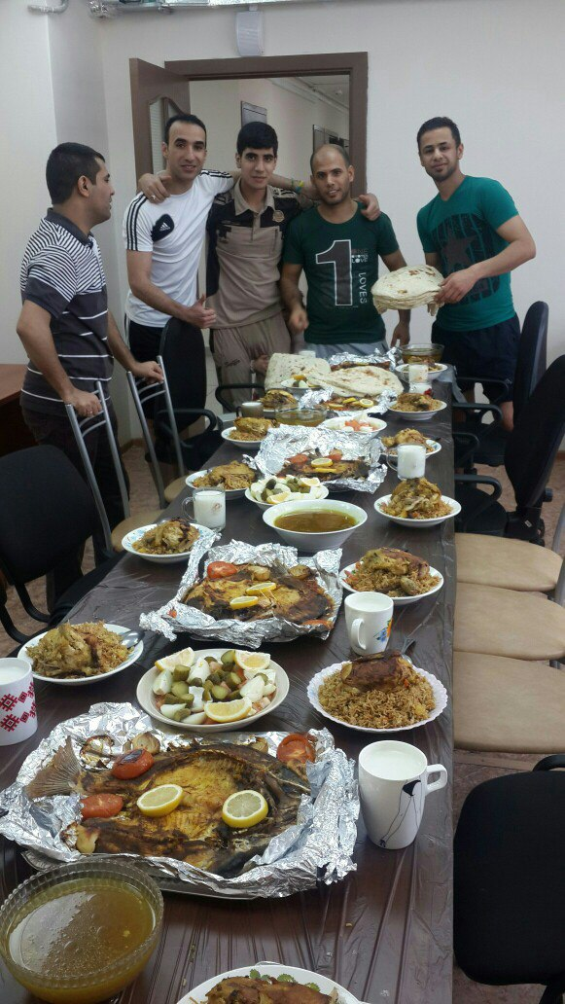
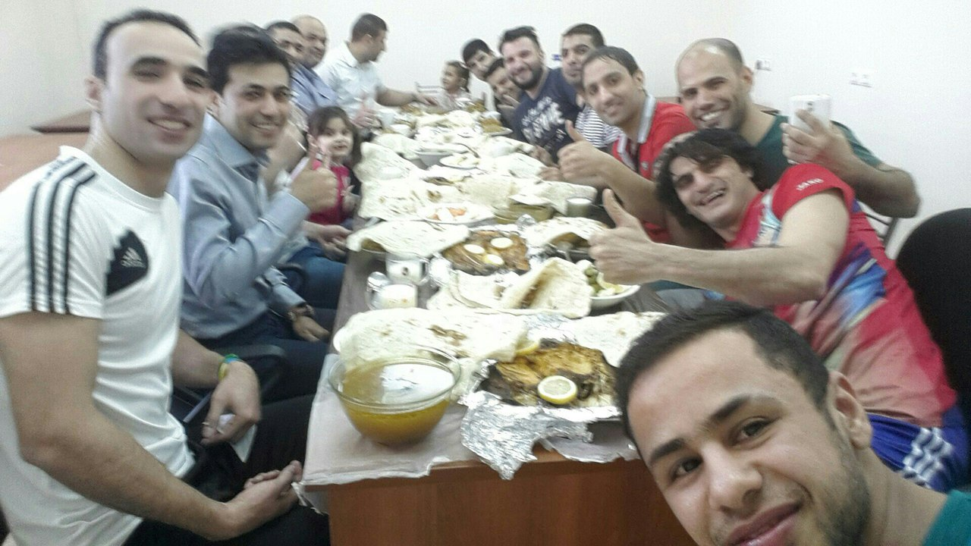

Slide 19
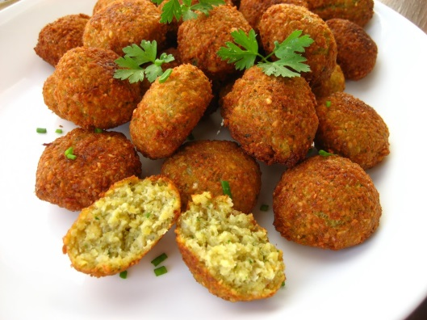
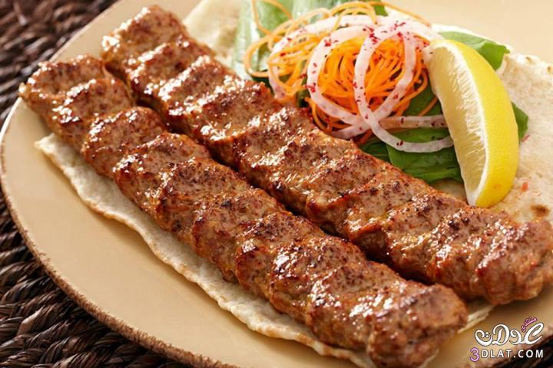
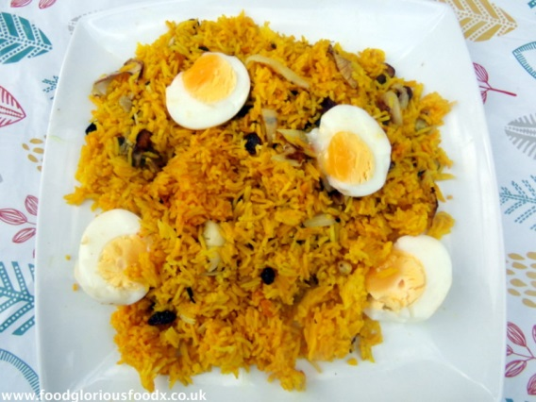
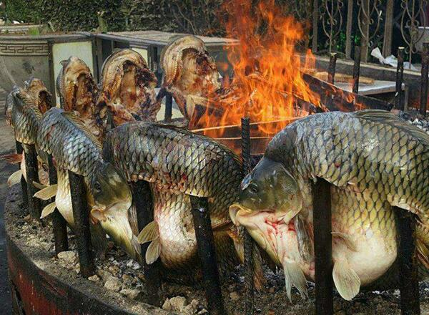
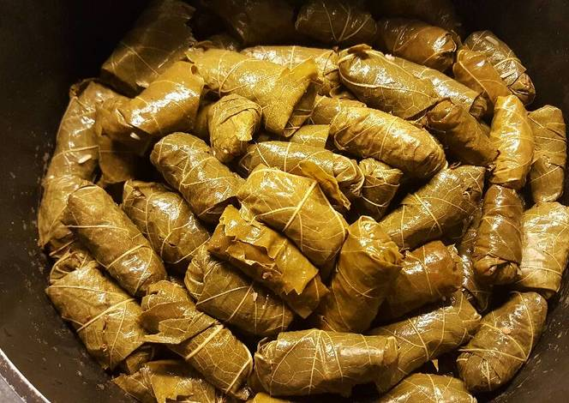
Cuisine
Falafel
Kofta
Kabab
Bryani
Dolma
Masgouf

Slide 20
Arabic language
Arabic is read from right to left
Almost all the letters in an Arabic word are joined together like hand writing
Some letters can’t join because of their shape.
There are 28 letters in the Arabic alphabet
There is no such thing as capital letters versus small letters
There is no such thing as printing versus hand writing, Arabic is all hand writing.
Just about almost all Arabic vocabulary is made up of root/stem consonants that you can easily memorize.

Slide 21
Arabic alphabet

Slide 22
Arabic is the national language and is the mother tongue of an estimated 79% of the population.
Kurdish—the official language in Kurdish regions.
The Turkomans speak a Turkic dialect.

Slide 23
Why Arabic language is difficult
There are quite a few different dialects It is difficult.
There are lots of letters and sounds that do not exist in the English language.
Develop a different set of muscles or facial features to accommodate some of the sounds in the language.
Speak from the back of your throat in order to properly make some of the sounds required for speaking Arabic.

Slide 24
Music and poetry

Slide 25
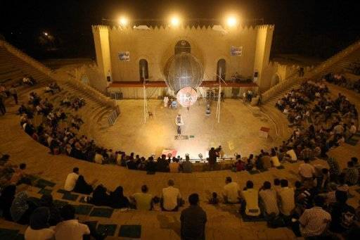
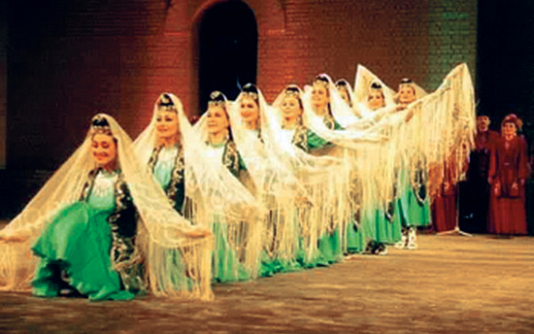
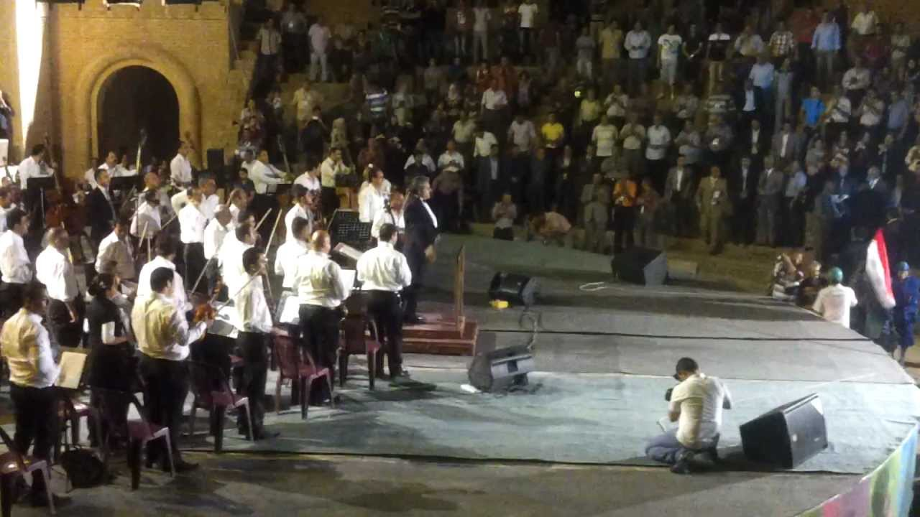

Slide 26
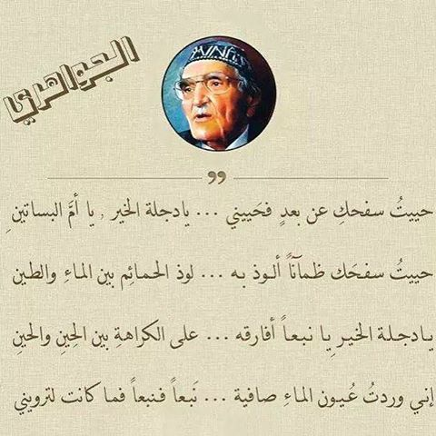

Slide 27
Thanks for your attention

