Slide 1
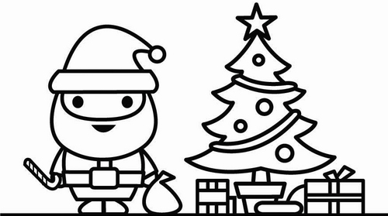
An American Christmas in Izhevsk
Students of all skill levels are welcome to come learn about the cultural differences between the holiday seasons in the US and Russia!
Come to Room 310 at 16:30 on 20 December for music, fun, and Christmas spirit!
Hosted by Adam Emerson, Fulbright ETA from the United States.

